Slide 1
Campus bridge:
Title: Integrated Academic LMS + Coding Skill Development Platform
Platform Subtitle: A Web Application for University
Team Name: Squad Goals
University name :Mohan Babu University
Team members:
»Dedeepya baratam:24102A040572
»Saladi toshita: 24101A030199
»Shaik Shareeqah Anjum: 24102A040620
»B.K.Y.Krishna : 24102A040567

Slide 2
Project Overview: Campus Bridge
Points:
⦿Campus Bridge is a web application designed to integrate academic learning and coding skill development for university students.
⦿The main aim of our project was to provide a seamless and holistic learning experience by combining the functionalities of a Learning Management System (LMS) with a coding skill development platform.
⦿Our main goal was to create a platform which offers features for students, faculty/trainers, and administrators/placement officers.
Problem Statement
Title:
Problem Statement: The Need for Integration Points:
⦿Current Scenario: Students often use separate, disjointed platforms for academic work and coding practice.
⦿Inefficiency: This separation leads to fragmented learning, duplicated effort, and difficulty in tracking overall progress.
⦿Lack of Holistic View: Universities struggle to get a comprehensive view of a student's academic and technical capabilities.
a single solution for all stated problems – campus bridge: A platform addresses these issues by providing an integrated learning environment.

Slide 3
Tech Stack Used
Frontend: HTML- to create the home page and content
CSS- to change the look
JavaScript- to make the website interactive
Backend: Node.js- for building a scalable and efficient API
Django- for the backend framework
Java Script- leveraging JavaScript on the server-side.

Slide 4
Key Features and ModulesPoints:
⦿ Student Interface LMS Module: Course access, materials, assignments, attendance.
⦿ Coding Module: Coding tracks, practice questions, code editor/compiler.
⦿ Progress Tracking: Skill heatmaps, badges, weekly streaks. Faculty & Trainer.
⦿ Panel Content Management: Uploading materials, scheduling.
⦿ Assignment Creation: Coding assignments, test cases.
⦿ Performance Monitoring: Academic and coding progress dashboards.
⦿ Admin/Placement Panel Analytics: Skill metrics, leaderboards, placement readiness index.
⦿ Management: Mock tests, coding contests, academic eligibility.

Slide 5
AI and Additional Technologies Points:
. Used Ai for better performance and code doubts
. Used vs code for connecting files and folders
.Used git hub for some code doubts

Slide 6
Conclusion and Future Scope Points:
The key benefits of Campus Bridge:
Finally, It makes the student to acquire unified learning, improve their efficiency, enhanced student experience and to have better placement outcomes.

Slide 7
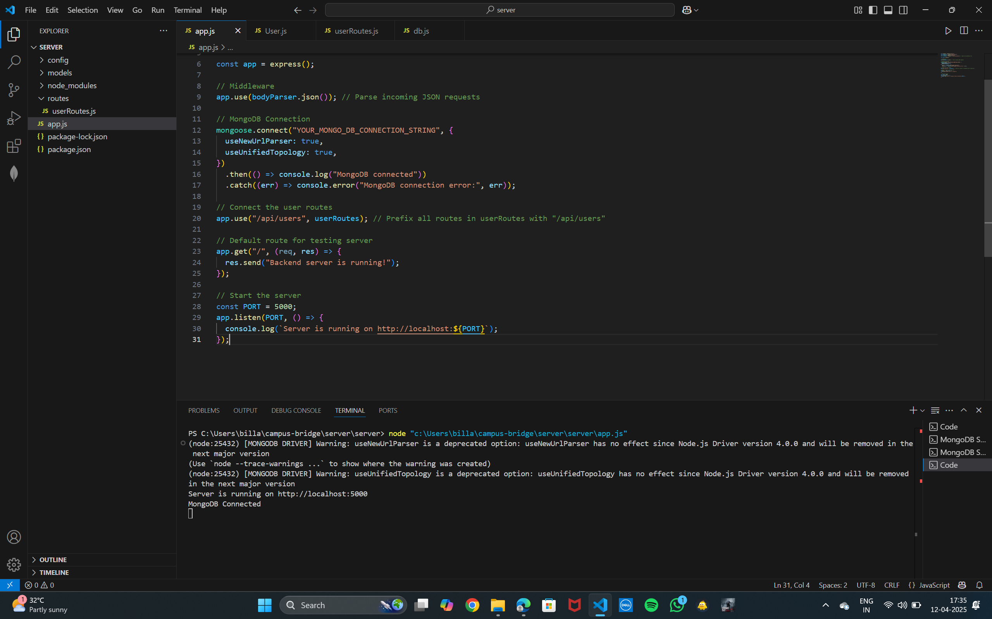

Slide 8
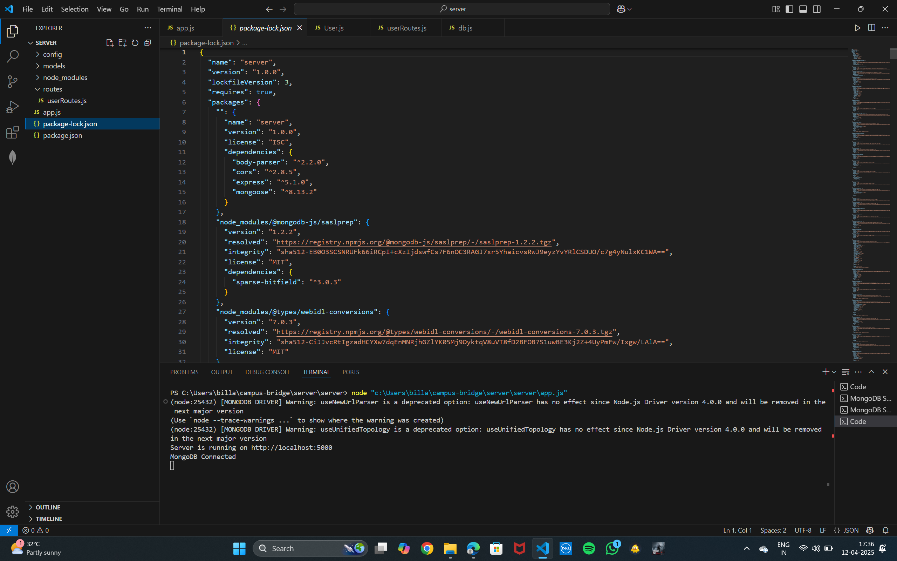

Slide 9
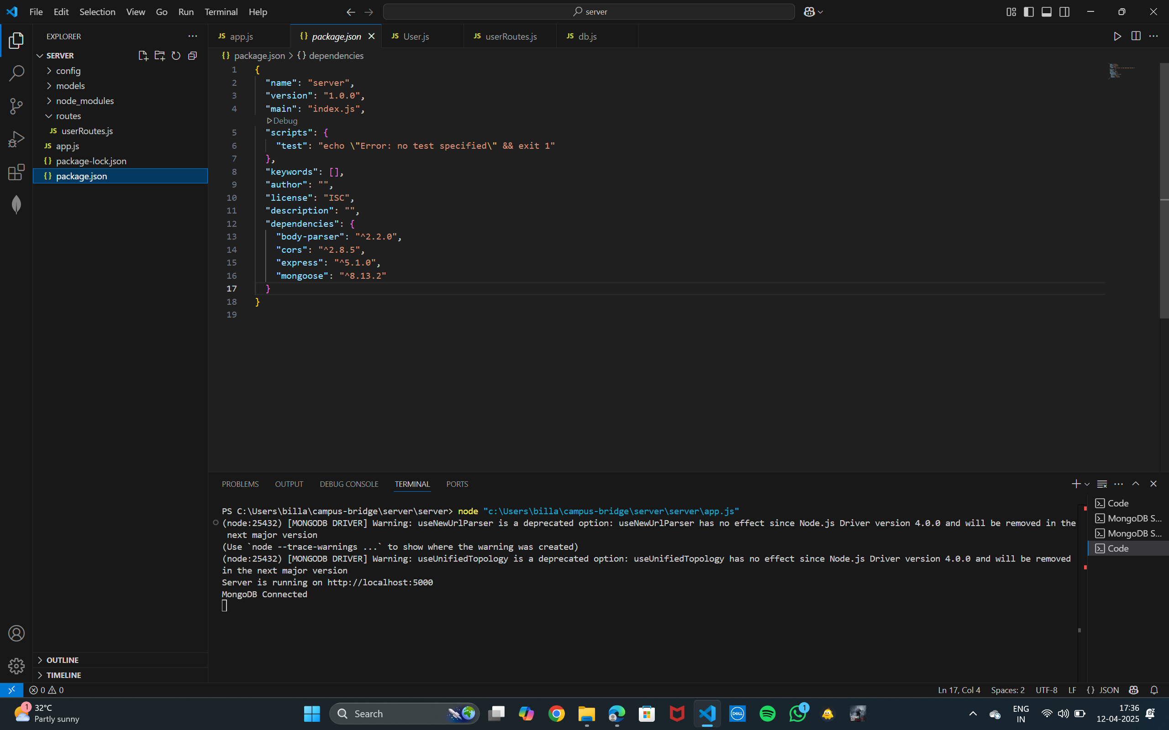

Slide 10
Thank You

